Slide 1


Architecture & Systems Engineering
Week 4: Modeling with DSMs and Modularization
Project Portfolio
Name

Slide 2
Instructions
Before you begin, you should save your Project Portfolio on your local drive. We recommend the following format:
Lastname_Firstname_Course1_Week4
Please note: You will not be able to re-download your file after submission; therefore, please keep this file in a central location for future reference.
While you will begin working in groups again this week, the project deliverable is an individual submission. A scoring rubric can also be downloaded from the course in the Resources/Downloads on the top Navigation.
Like last week, in Week 4 you will be self-assessing your work as well as the work of three peers in the class. If you have any questions, feel free to start a thread in the Discussion Forum. Although work is strictly individual, sharing ideas and concepts with other students is encouraged.
Note: edX has a 10MB file size limit for document submission. If you have selected large image(s), you may need to resize before submitting, OR you may simply include a web URL for the image in the image location. Be sure to submit your assignment at least one hour before the deadline to provide time for troubleshooting.
Once the deadline passes, you will not be able to upload the document and therefore will not be able to submit and complete the assignment.
Peer assessment is limited to 300 characters.
2

Slide 3
Week 4 Project
Overview
In the fourth project activity of this course, you will continue to build on the system your team selected during Week 3. We will further study the system by decomposing it and reviewing its change propagation properties. The steps on the right will guide you through this process.
Note that some Scratch Pages are included at the end of this document for you to capture any ideas, sketches, etc. you have as you work through the project. These will not be assessed and you are not required to submit them with your project (but you may do so if you think they offer any additional insight into your thinking process!).
REQUIRED STEPS:
Step 1: Decompose the system.
Step 2: Analyze the system DSM.
Step 3: Identify the change propagation.
Step 4: Review and submit your project.

Slide 4
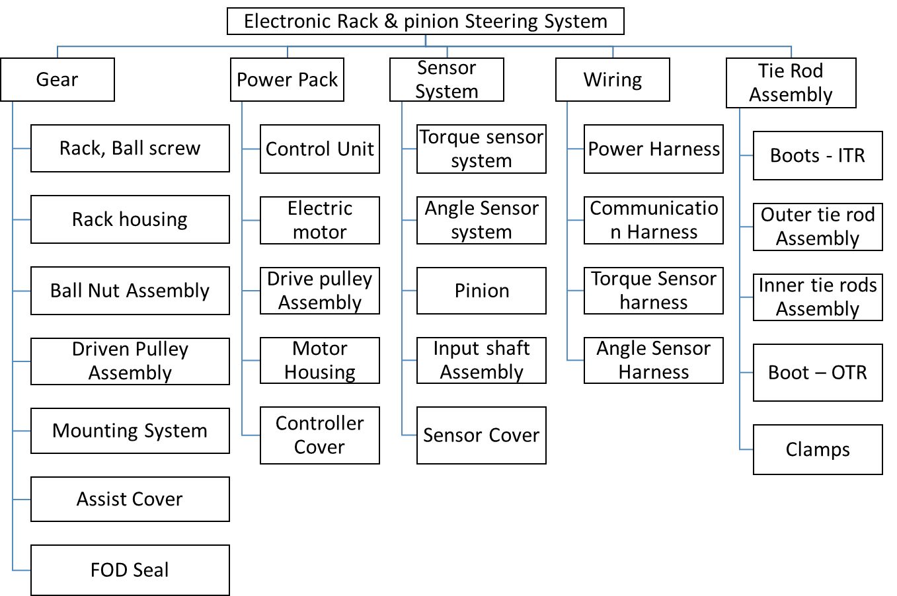
STEP 1: DECOMPOSE THE SYSTEM
For your system chosen in Week 3, develop a system decomposition. The system decomposition should be (1) of form (objects), (2) a two-level down decomposition with 7±2 components per level and (3) shown as a tree structure or an indented list.
Please remember the file size limit and resize or paste the image URL instead, as needed.
Name of System:
Electronic rack & Pinion Steering System
System Decomposition:

Slide 5
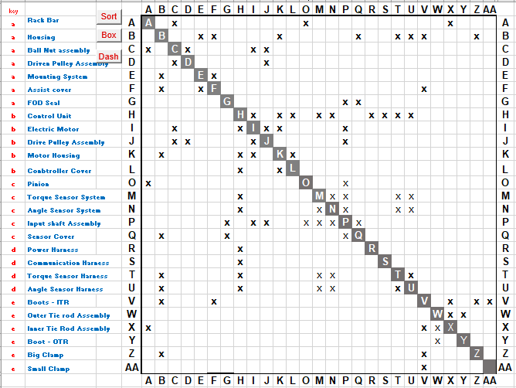

STEP 2A: SYSTEM DSM
Based on your Level Two system decomposition from Step 1, develop a N x N Design Structure Matrix. Clearly label each row and column. Attempt to arrange objects in the order of decomposition. This will allow you to match Level One modules in the DSM.
Please remember the file size limit and resize or paste the image URL instead, as needed.
System DSM
Insert DSM image here.

Slide 6
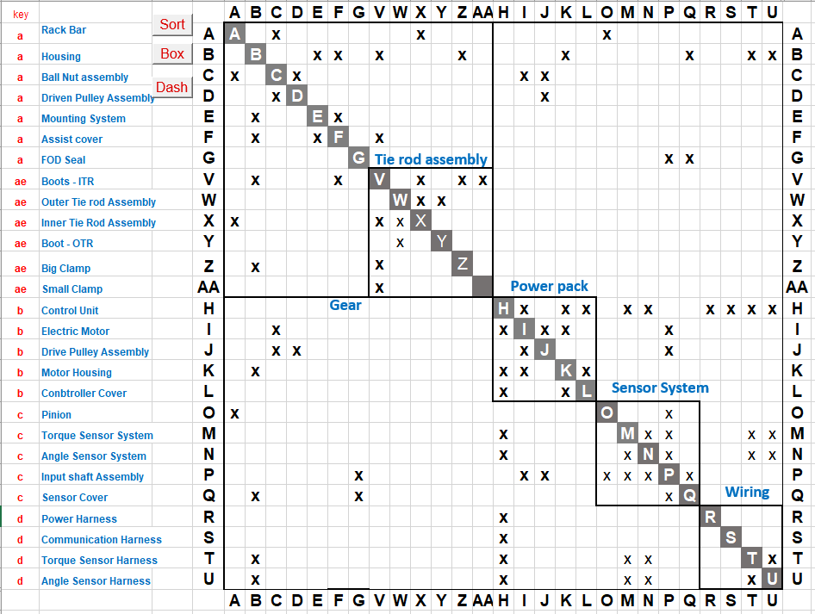
STEP 2B: SYSTEM DSM
Given the DSM developed in the previous step, attempt to cluster or partition one level up in order to expose modules of the system. Are the modules identical or different than your form decomposition from Step 1? What insights can you gain as an architect from a DSM? Please use the DSM Excel file provided in this module.
Please remember the file size limit and resize or paste the image URL instead, as needed.
System clustering:
5 clusters
Insert image of modularized DSM here.

Slide 7
STEP 3: CHANGE PROPAGATION
Given the DSM developed in Step 2A, identify a sorted list of Level Two objects (top five) which would create a large change propagation impact. In essence, what are the top components which would represent the largest change propagation chains in the system? List the components and identify up to three of the longest chains of propagation among the components. When thinking about change propagation, it is useful to remember that changes often exceed two generations, but rarely exceed five. Parts of a system being interconnected does not necessarily lead to endless change propagation, and in real world projects propagation depends on a lot of contextual factors.
Change propagating components:
Component description | Number of Interfaces of the component | Change chain propagation [c1-c2-cX], [c1-c4-cX]
Control Unit | 9
Housing | 8
Input shaft Assembly | 6

Slide 8
STEP 4: REVIEW & SUBMIT PROJECT
Submit your completed Week 4 Project Portfolio file.
Complete Self-Assessment of Project
Complete Peer Assessments of Project (Peer assessment is limited to 300 characters)
Note: The maximum file size that can be submitted is 10MB.
A sample project submission and scoring rubric can be downloaded from the course in the Resources/Downloads tab on the top navigation.
Please remember that there are three steps to this assignment: Submission, peer assessment, and self assessment. Please provide enough time by each deadline to complete your assignment on time, as it is not possible to submit once the submission window closes.

Slide 9
Scratch Page*
Reminder: edX has a 10MB file size limit for document submission. If you have selected large image(s), you may need to resize before submitting, OR you may simply include a web URL for the image in the image location. Be sure to submit your assignment at least one hour before the deadline to provide time for troubleshooting
Please remember the file size limit and resize or paste the image URL instead, as needed.

Slide 10
Scratch Page*
Reminder: edX has a 10MB file size limit for document submission. If you have selected large image(s), you may need to resize before submitting, OR you may simply include a web URL for the image in the image location. Be sure to submit your assignment at least one hour before the deadline to provide time for troubleshooting
Please remember the file size limit and resize or paste the image URL instead, as needed.

